Slide 1
reduce() in Python
DVT101 – Lecture 19
- By Dataverse Tutorials

Slide 2
What is reduce() in Python?
Used to reduce iterable into a single value
Part of functools module
Applies function cumulatively
Useful for sum, product, concatenation

Slide 3
Core Concept of reduce()
Higher-order function
Takes function + iterable
Returns single value
Executes step-by-step

Slide 4
Syntax & Internal Working
reduce(function, iterable, initializer)
Function takes 2 arguments
Result flows forward
Optional initializer

Slide 5
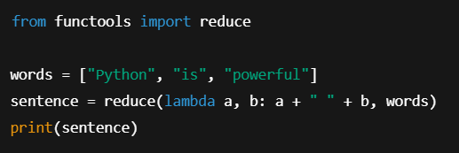
String Concatenation using reduce()
reduce() can be used to merge multiple strings into a single string
It processes elements pair by pair from left to right
A lambda function defines how two strings are combined
Useful for building sentences, logs, or combined messages
Returns a single final string value

Slide 6
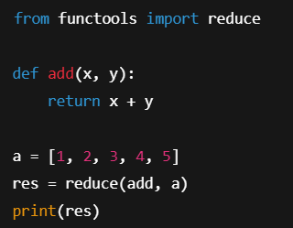
reduce() with Named Function (Sum)
how reduce() works
normal user-defined function

Slide 7
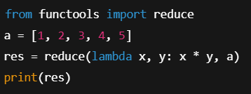
Factorial using Lambda
how reduce() can be used
calculate factorial-like multiplication

Slide 8
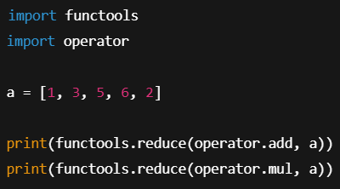
reduce() with operator module
operator module as a cleaner alternative

Slide 9
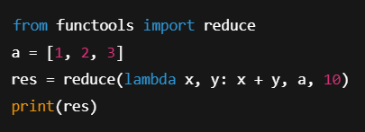
Using Initializer
How initializer reduce affect on execution

Slide 10
reduce() vs accumulate()
reduce → final value only
accumulate → intermediate values
accumulate from itertools

Slide 11
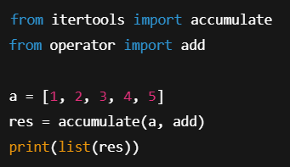
accumulate Example
How accumulate() returns intermediate results, unlike reduce.

Slide 12
Industry Use Cases
Data aggregation
ML feature engineering
Financial calculations
Stream processing

Slide 13
Summary & Key Takeaways
reduce collapses iterable → single value
Best for simple cumulative logic
Avoid for complex flows
Readability matters

Slide 14


